Slide 1
Po Shan Landslide 1972
Jingwen He, Elise Jackson
CEEn 544

Slide 2
HongKong

Slide 3
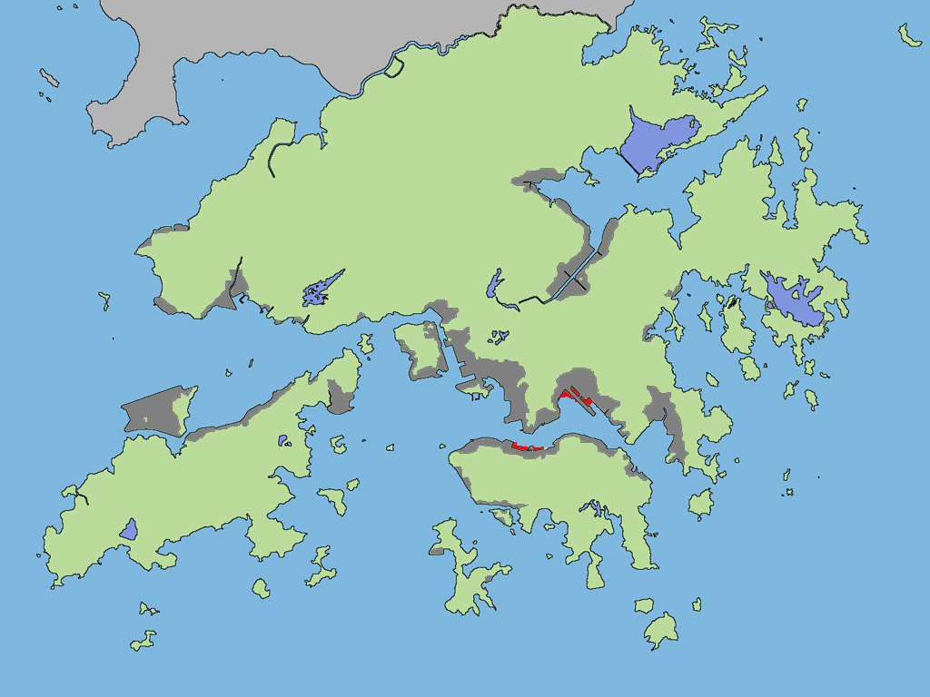
Hilly Natural Terrain
Land Reclamation
Residential Areas

Slide 4
Po Shan Hillside
Po Shan hillside is underlain by thick bouldery colluvium
susceptible to development of high groundwater levels
failure when disturbed by construction activities
Steep terrain
History of landslides during heavy rainfall

Slide 5
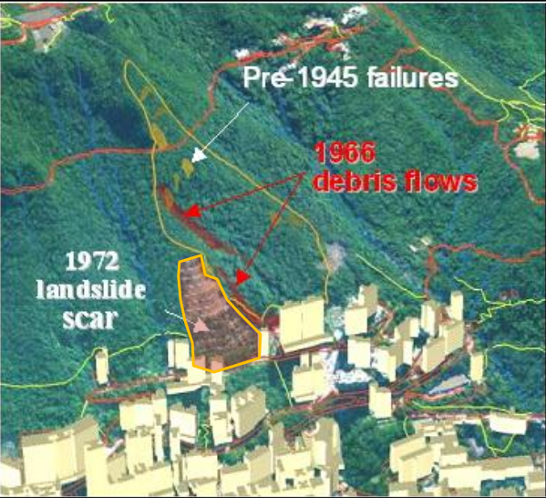

Slide 6
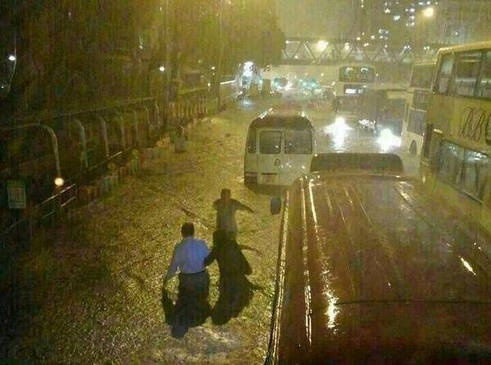
1972
Unusually high volume of rainfall
Notes:
Twice as the average rainfall for June. The 5th highest on the record

Slide 8
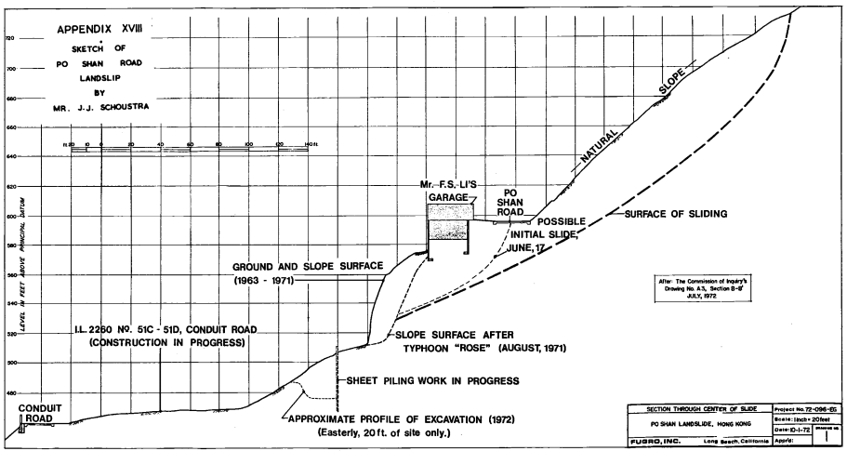
Geotechnical Study of Slide

Slide 9
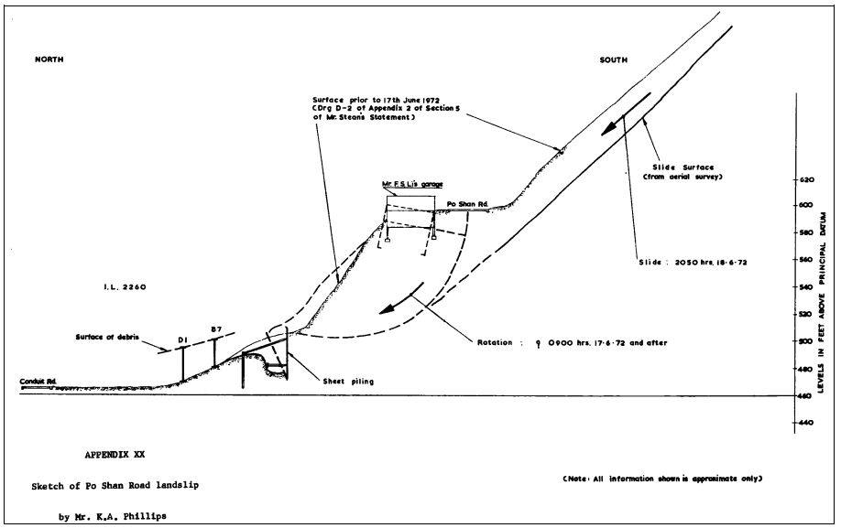
Notes:
Assumed FS of 1.5 along cut, but didn’t take into account the excessive rainfall.

Slide 10
Recommendations
Regular inspections by engineers
Construct water mains of non-brittle materials to avoid problems from differential settlement
Drainage necessary on slope to prevent future disasters

Slide 11
Remediation
Vertical Drain System
Avoids problems from horizontal loads due to seismic forces
Flexible barriers installed for shallow landslides

